Slide 1
Introduction to Computer Vision
ENGR430 Computer Vision
Roger Williams University
Matthew Stein

Slide 2
Slides largely copied from SCE 643: Introduction to Computer Vision
Jinxiang Chai
Texas A&M University
Also Davi Geiger New York University 2004
Slide or two from other sources
Notes:
2

Slide 3
What is Computer Vision?
Extracting information from camera signals
A sensor modality for robotics
Inverse of Computer Graphics
Computer
vision
World
model
World
model
Computer
graphics

Slide 4

Components of a computer vision system
Data
Camera
Lighting
Computer
Scene
Scene Interpretation
Srinivasa Narasimhan’s slide

Slide 5
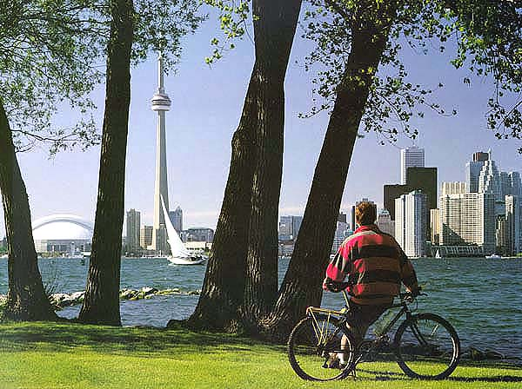
General visual perception is hard
What kind of scene is this?
Is there a human in this scene?
How far away is the tower?
How far are the trees?

Slide 6
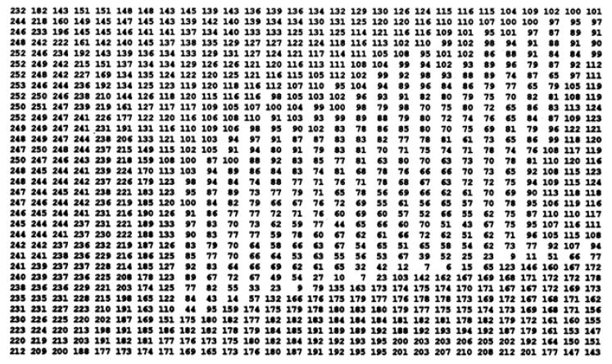
Digital Image
To the computer, this and all images are just a stack of numbers

Slide 7
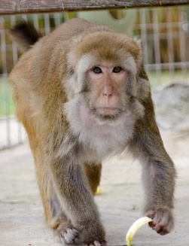
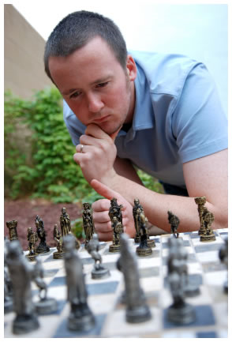
Vision is really hard
Vision is an amazing feat of natural intelligence
Visual cortex occupies about 50% of Macaque brain
More human brain devoted to vision than anything else
Is that a queen or a bishop?

Slide 8
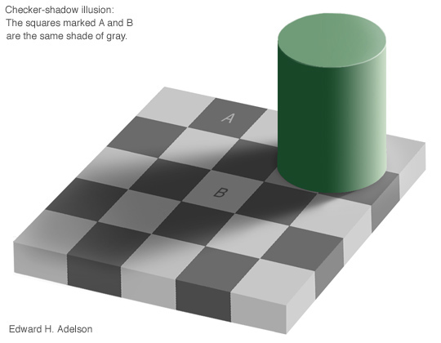
Vision is inferential: Light
(http://www-bcs.mit.edu/people/adelson/checkershadow_illusion.html)

Slide 9
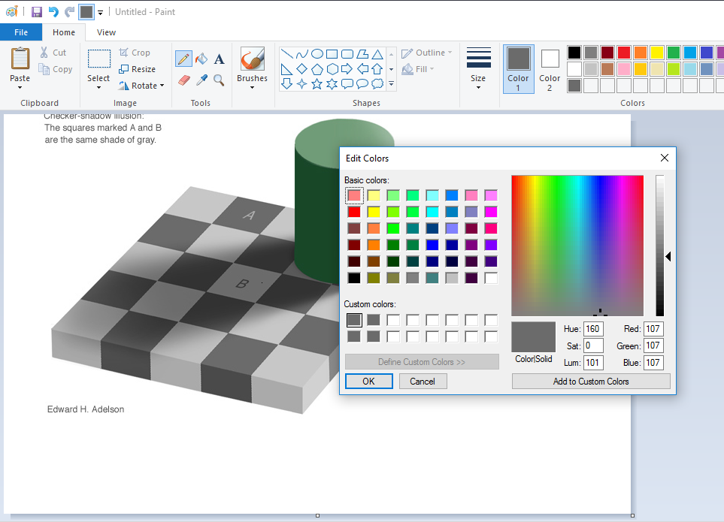

Slide 10
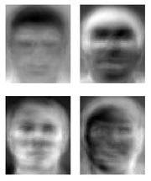
Ridiculously brief history of computer vision
1966: Minsky assigns computer vision as an undergrad summer project
1960’s: interpretation of synthetic worlds
1970’s: some progress on interpreting selected images
1980’s:Shift toward geometry and increased mathematical rigor
1990’s: face recognition; statistical analysis in vogue
2000’s: broader recognition; large annotated datasets available; video processing starts; vision & graphics; vision for HCI; internet vision, etc.
Guzman ‘68
Ohta Kanade ‘78
Turk and Pentland ‘91

Slide 11
Computer Vision Techniques
Write algorithms in a programming language to manipulate the raw image data to extract useful information
Like what?

Slide 12
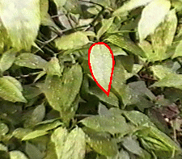
Boundary Detection
http://www.robots.ox.ac.uk/~vdg/dynamics.html

Slide 13
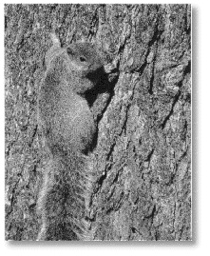
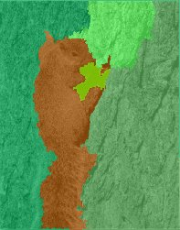

Slide 14
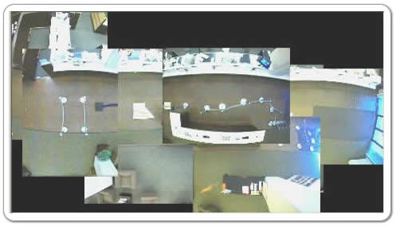
Tracking: feature changes location in a sequence of images

Slide 15
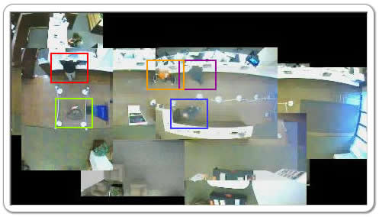
Tracking

Slide 16
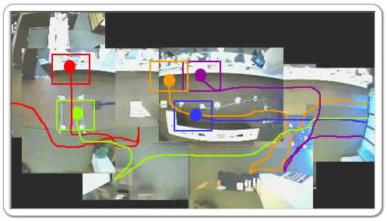
Tracking

Slide 17
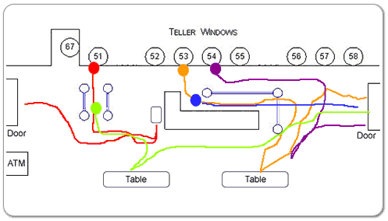
Tracking

Slide 18
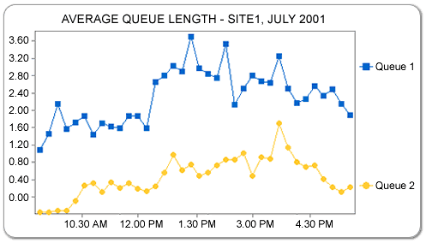
Tracking

Slide 19
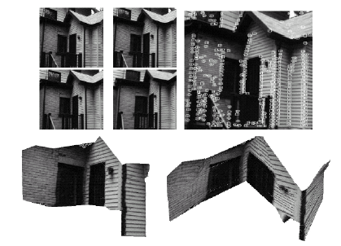
Reconstructing 3D from a sequence of images from a moving camera
http://www.ai.mit.edu/courses/6.801/lect/lect01_darrell.pdf

Slide 20
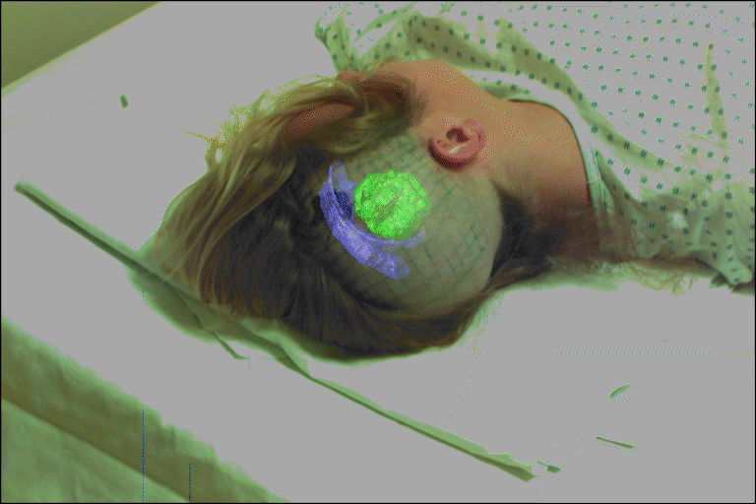
Pose Determination:
Known camera location ⇒ determine position of a roughly known object
Object location known ⇒ determine location of camera

Slide 21
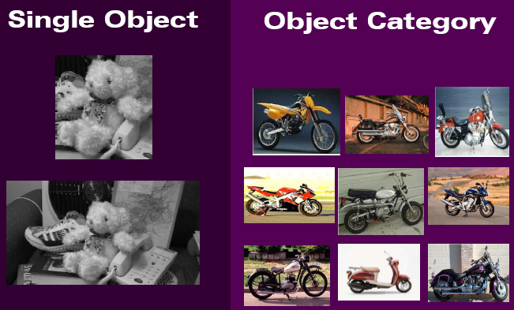
Classification
Fei-Fei Li.

Slide 22
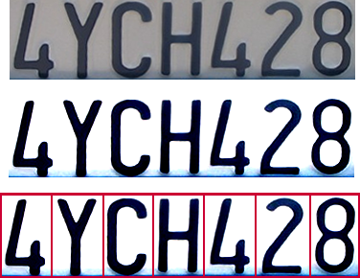

Application: Optical character recognition (OCR)
Technology to convert scanned docs to text
If you have a scanner, it probably came with OCR software
Digit recognition, AT&T labs
http://www.research.att.com/~yann/
License plate readers
http://en.wikipedia.org/wiki/Automatic_number_plate_recognition

Slide 23
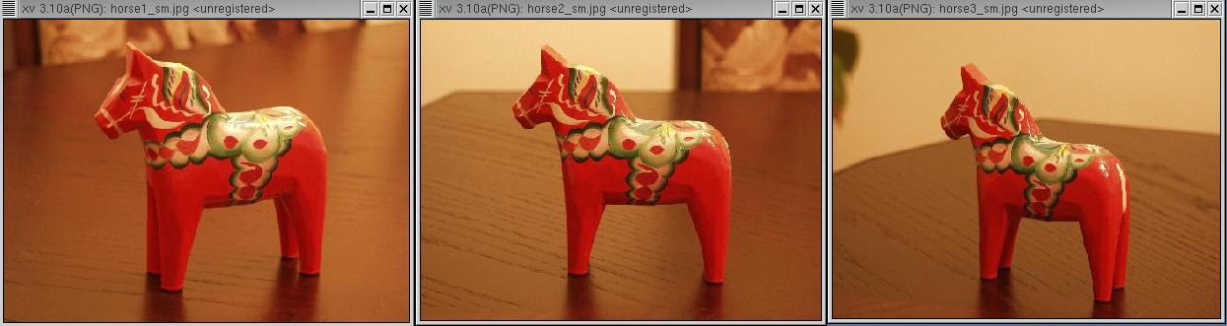
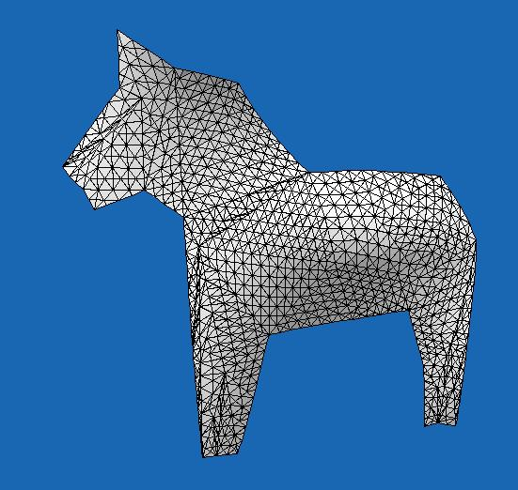
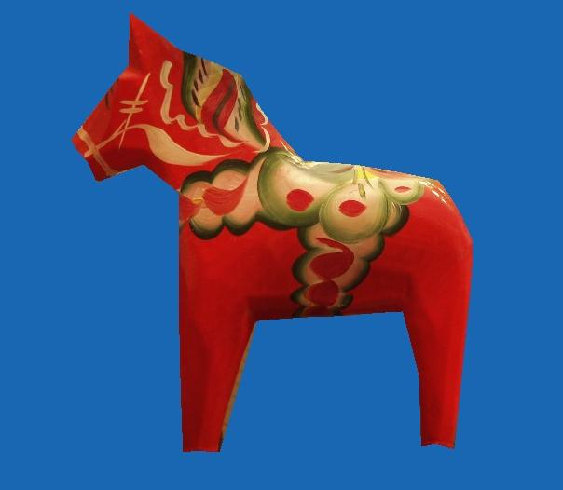
Applications: 3D Reconstruction

Slide 24
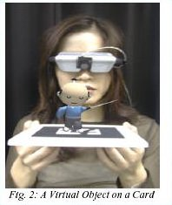
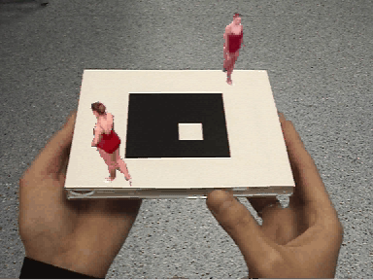
Augmented Reality

Slide 25
Panoramic Mosaics
+
+ … +
=

Slide 26
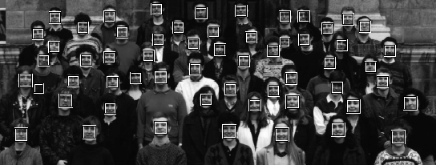
Applications: Recognition

Slide 27
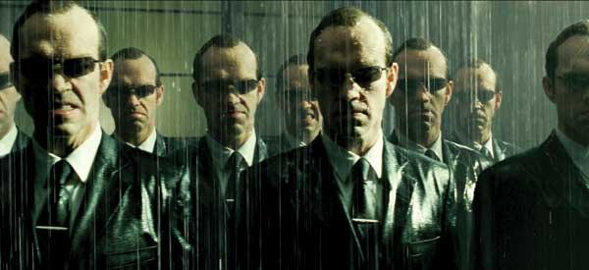
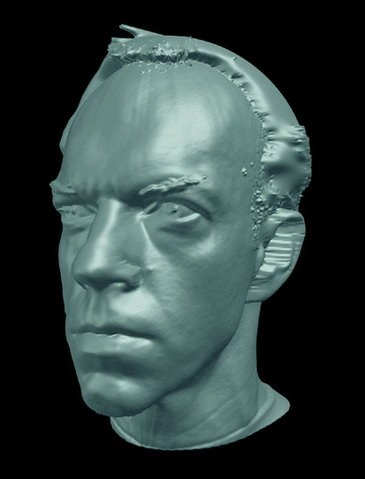
Applications: Special Effects
ESC Entertainment, XYZRGB, NRC

Slide 28
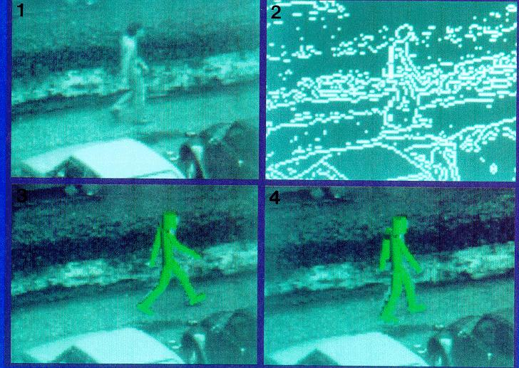
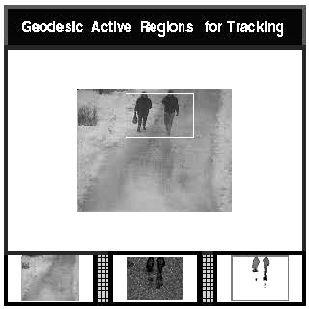
Applications: Surveillance

Slide 29
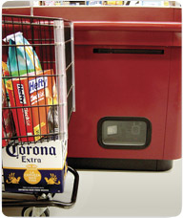
Application: Object recognition (in supermarkets)
LaneHawk by EvolutionRobotics
“A smart camera is flush-mounted in the checkout lane, continuously watching for items. When an item is detected and recognized, the cashier verifies the quantity of items that were found under the basket, and continues to close the transaction. The item can remain under the basket, and with LaneHawk,you are assured to get paid for it… “

Slide 30

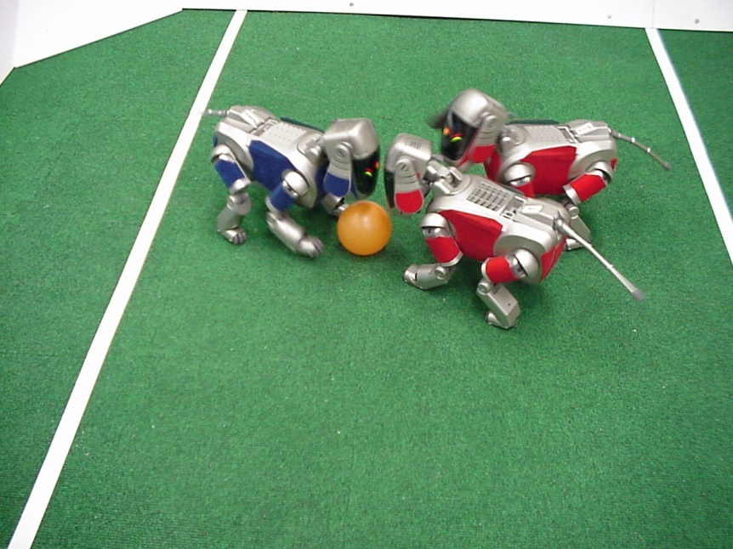
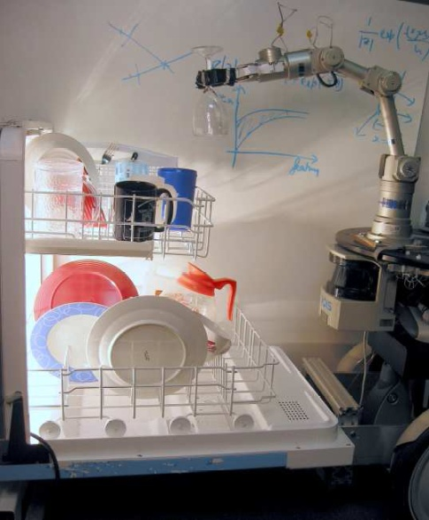
Application: Mobile robots
NASA’s Mars Spirit Rover
http://en.wikipedia.org/wiki/Spirit_rover
http://www.robocup.org/
Saxena et al. 2008
STAIR at Stanford

Slide 31
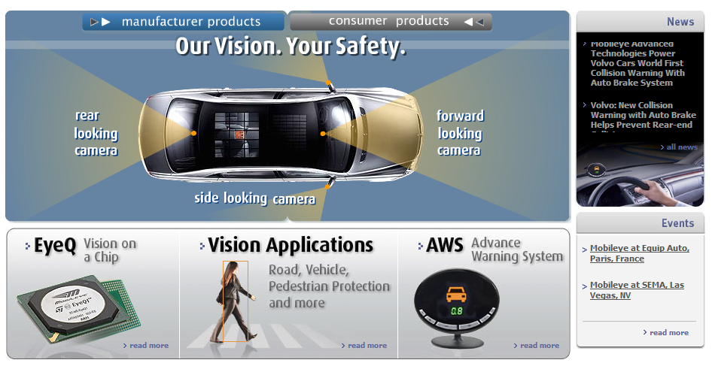
Application: Smart cars
Slide content courtesy of Amnon Shashua
Mobileye [wiki article]
Vision systems currently in high-end BMW, GM, Volvo models
By 2010: 70% of car manufacturers.

Slide 32
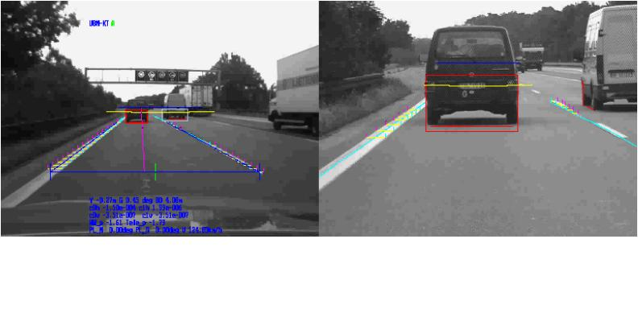
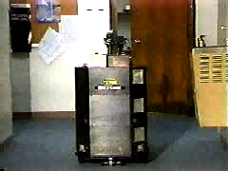
Autonomous Vehicle
Flakey, SRI
Notes:
DARPA (Defense Advanced Research Projects Agency) gave $2 million dollar prize to challenge teams that developed autonomous vehicles to travel long distance across difficult terrains.
The last two competitions were done in the desert. In 2005, the winner is the Stanford University. They completed a 131 mile course in Mojave Desert in under 10 hours.
Last year, the competition is done in an urban environment. The autonomous vehicles are expected to drive in a city together with other human drivers. They should obey traffic laws, handle complex intersections, follow the traffic, overtaking slow vehicles, etc. The winner is a team from the CMU.

Slide 33
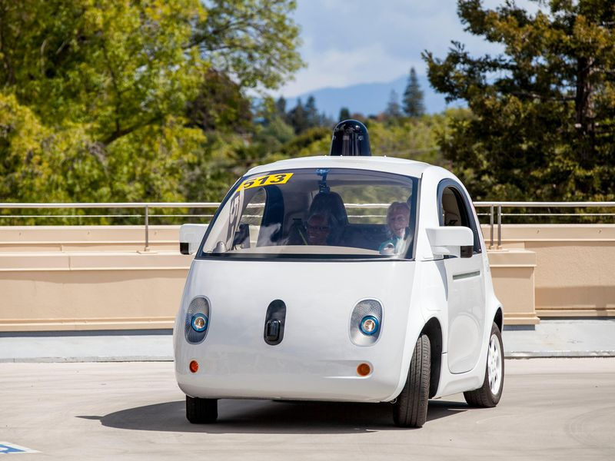
Application: Self-driving cars

Slide 34
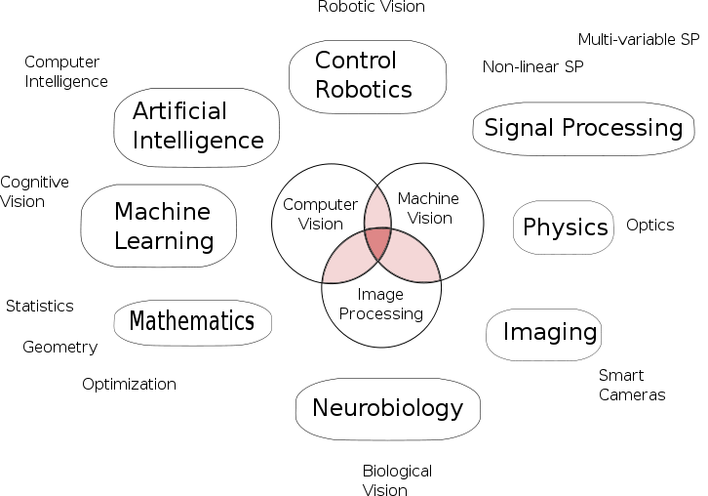
Vision is multidisciplinary
Computer Graphics
HCI
From wiki

Slide 35
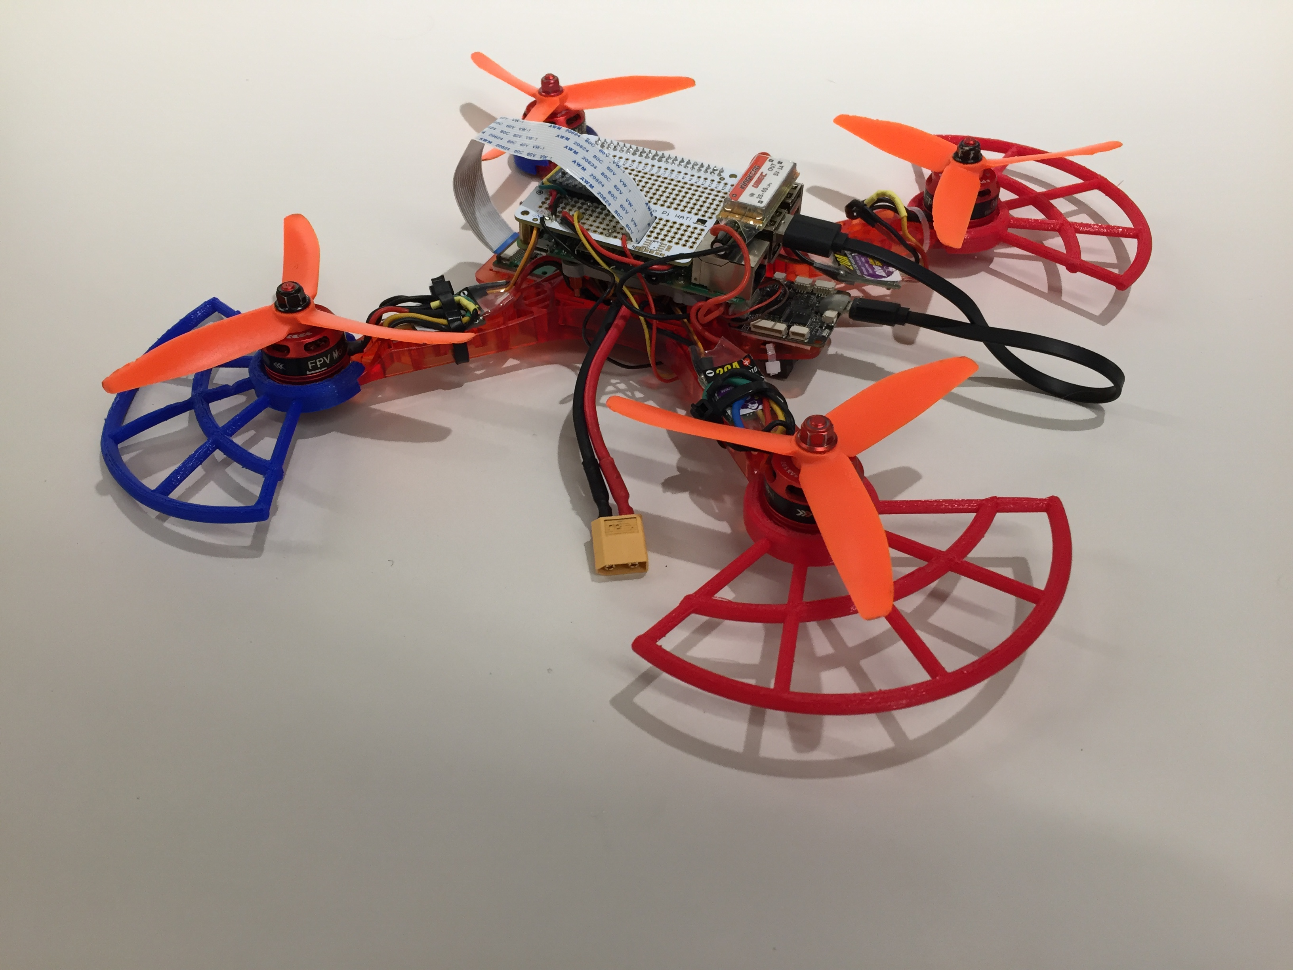
OK, so what about us?
This is all terribly exciting, but what are we actually going to do?

Slide 36

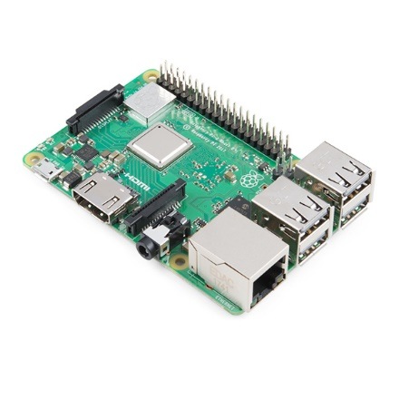

Programming
Linux operating system
Raspberry Pi computer
Python programming language
OpenCV library

Slide 37
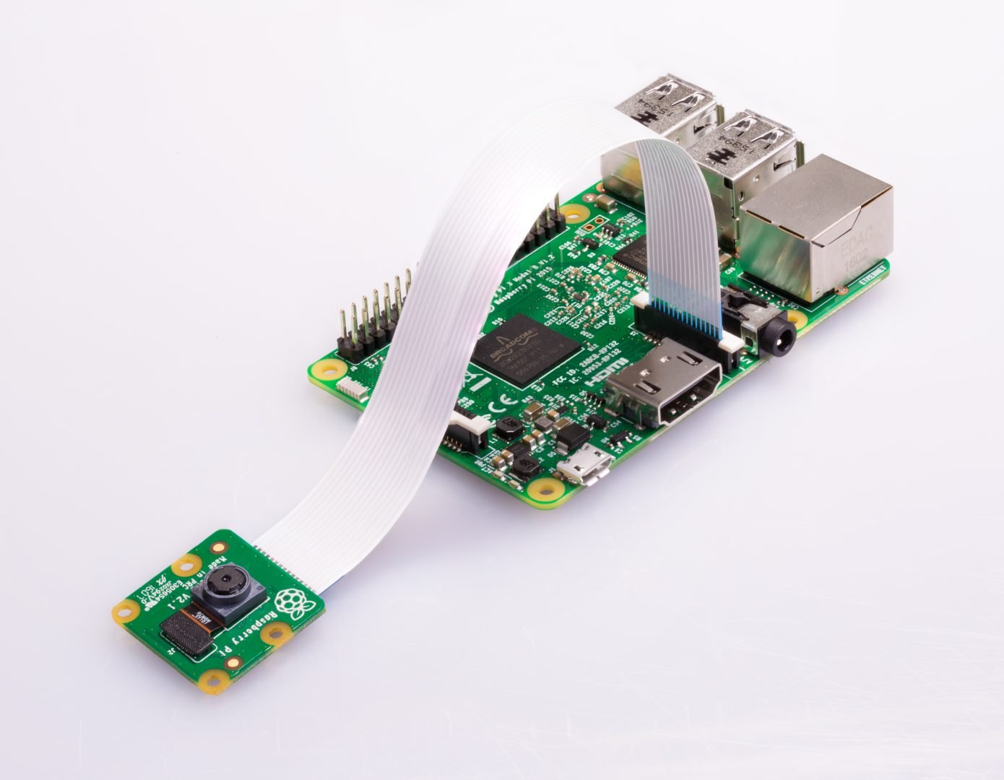
Vision: Raspberry Pi Camera

Slide 38

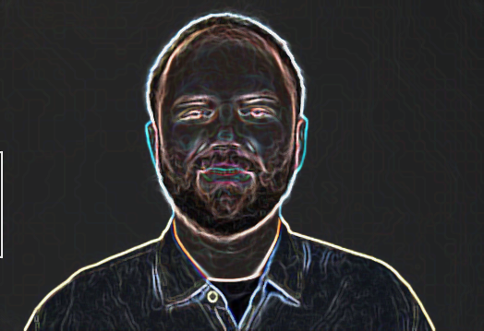
Write Python programs using OpenCV to manipulate images
“Middle aged white guy”

Slide 39
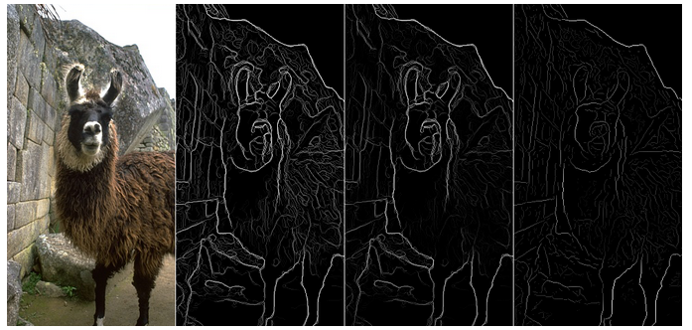
Write filters in python to manipulate images

Slide 40
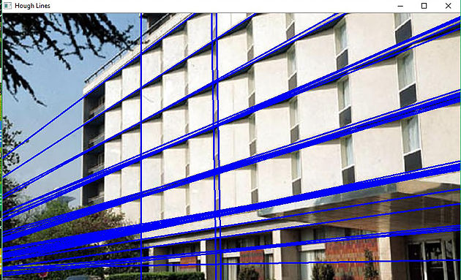
Hough line detection in Python

Slide 41
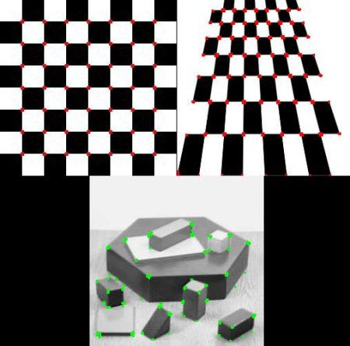
Feature detection

Slide 42
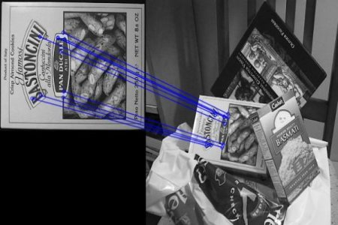
Feature matching

Slide 43
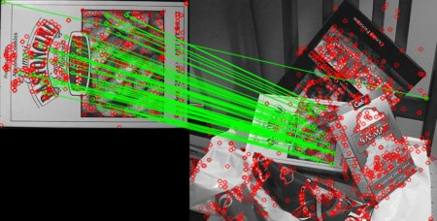
Transform extraction

Slide 44
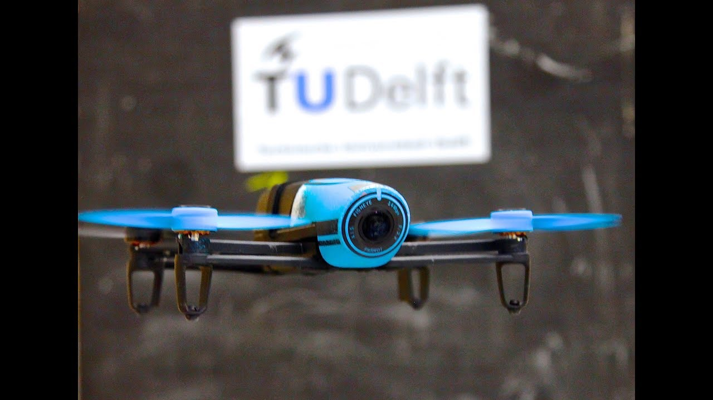
Vision based position control

